Slide 1
Designing with FPGAs
part one

Slide 2
Basic::basics
FPGA – Field Programmable Gate Array, origins in PLD / CPLD
(Re)programmable “soft-hardware” development platform
4 Major players in the FPGA space: Xilinx, Altera, Microsemi, Lattice
Most common by far are Xilinx & Altera
Microsemi common in Mil/Aero Applications (Flash-based, OTP, bitstream encrypted, great for ultra-low power applications)
Lattice niche / less common (not bad, just not as common), on-device Flash config features
By the numbers:
Xilinx – $2.382 billion Microsemi - $835 million
Altera – $1.783 billion Lattice - $332.5 million

Slide 3
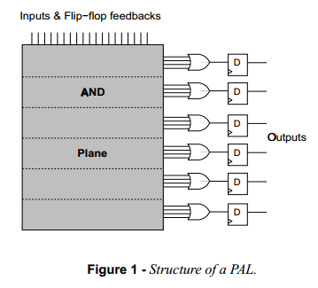
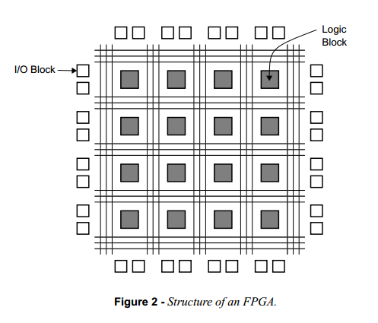
Distinctions – PLD, CPLD, FPGA
FPGAs have their origins in PLDs & CPLDs
PLDs popularized in the 70s and 80s – PAL, PLA devices (also referred to as SPLDs following the advent of CPLDs)
PALs / PLAs distinguished by way logic resources connected along a programmable array
CPLDs implement “more of the same” – PLD-esque cells connected along a programmable fabric
FPGAs implement small logic elements (CLBs / LUTs) in huge number with fewer inputs and tighter features, more flexible, more capable, better resource options
Prices are tightening up – CPLDs *not* always the cheaper option, CPLDs not necessarily a lower power option, despite having fewer resources

Slide 4
How to pick the right device:
Application / Device parameters
Device size
Logic Resources (CLBs / LUTs / ?Gates?)
Package (PCB Footprint)
IO Resources
Cost (FPGAs aren’t cheap when compared to MCUs)
Speed
Power consumption (FPGAs can suck power)
IO Standards
Programming model
Tools, tools, tools (if the tools suck, cost too much - move on)
All vendor tools have freemium model – entry level tools should be free, easy-ish
There is no Open-Source FPGA tool (may change when FPGA patents expire)
Device support #1 reason required to move to a paid tool, IP #2, features #3
There is no Mac OSX version of an FPGA tool (Linux, yes)

Slide 5
Questions to ask:
How many pins do I need?
Hard question to answer
What are you trying to do?
What do you need to interface to?
How good are your soldering chops? (BGAs are IO friendly, QFPs cost board area)
FPGAs are designed to scale – leave some headroom, design once, design “boardless”
Example – 5x SPI devices = 3 pins for MOSI, MISO, SCLK + 5 CS_N pins = 8 pins
What do I intend to use it for? How “big” does it need to be?
Glue logic takes very few resources, aim low (unless…)
$10 device can hold 2x 32-bit CPU cores just fine
Do I have external memory on my board?
FPGA block RAM is expensive, use external memory, save big on FPGA resources
Will I boot from SPI flash? (there goes a few pins)
Will it interact with a CPU, like an AVR? How many connections should I reserve?
Do I need any fancy IO resources?
Differential Pairs (LVDS)
High speed IO’s
Internal pullups / pulldowns
Curious slew rates or drive strengths

Slide 6
Questions to ask:
What are you willing to pay
Consider that a well done & scalable FPGA system could eliminate future NRE costs, build once & build to scale
Consider that FPGAs tend to go UP in cost over time, as they are EOL (compare Spartan 3 and Spartan 6)
What do I intend to use it for? How “big” does it need to be?
Glue logic takes very few resources, aim low (unless…)
$10 device can hold 2x 32-bit CPU cores just fine
Do I have external memory on my board?
FPGA block RAM is expensive, use external memory, save big on FPGA resources
Will I boot from SPI flash? (there goes a few pins)
Will it interact with a CPU, like an AVR? How many connections should I reserve?
Do I need any fancy IO resources?
Differential Pairs (LVDS)
High speed IO’s
Internal pullups / pulldowns
Curious slew rates or drive strengths

Slide 7
Building an FPGA Board

Slide 8
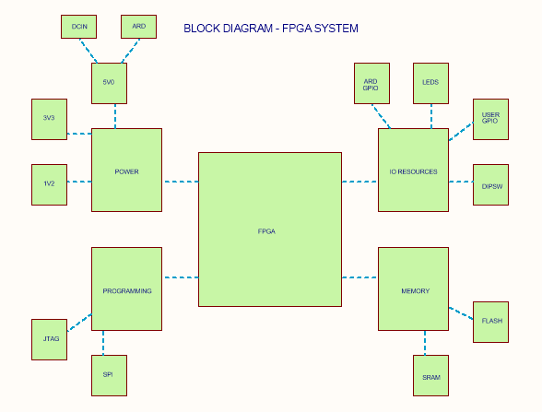
Top Level Diagram

Slide 9
Programming & Debug

Slide 10
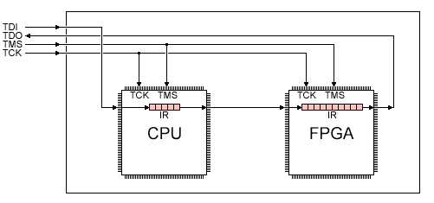
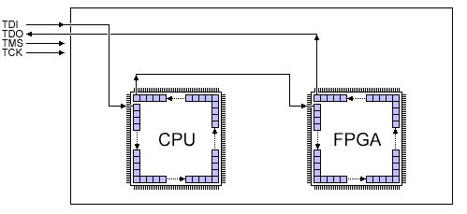
JTAG – Programming and Boundary Scan
Parallel to each device in the chain:
TCK – Test Clock: clock signal that all JTAG signals sync to
TMS – Test mode select: 16-stage state machine that determines what mode devices are in
Serial connection to each device in the chain:
TDI – Test data input
TDO – Test data output
Registers:
Shift IR – Shift Register - instructions
Shift DR – Shift register - data

Slide 11
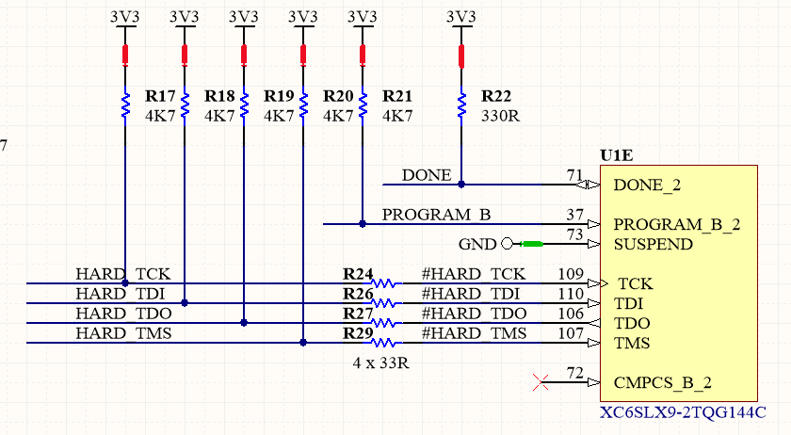
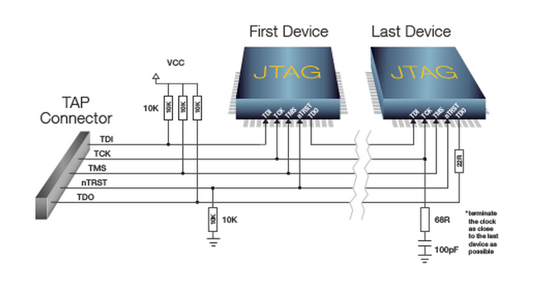
JTAG – Schematic Requirements
Pull-up resistors
Spec declares 10K pullups on TDI, TDO, TMS, TCK
Also series termination for TDO on last device, parallel termination on TCK (capacitor + resistor in series to GND)
Using 4.7K (stronger pullups) optimizes parts list and reduces comps
Series terminations reduce reflections, TCK isn’t a worry with single device

Slide 12
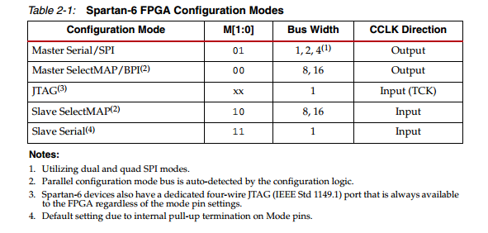
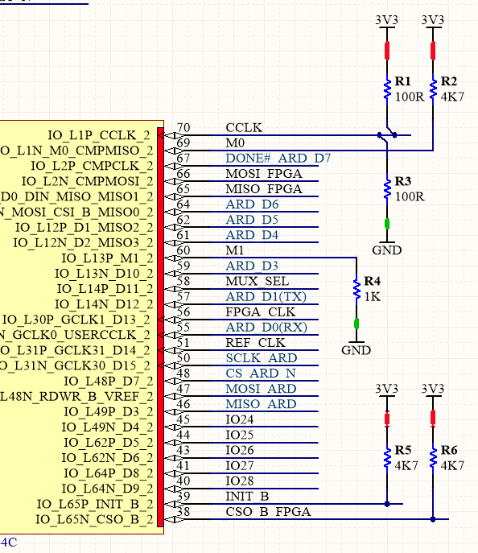
JTAG & SPI Programming
Mode Selection
Programming Via SPI flash requires device is in Master Serial program mode
Master with respect to the configuration CLK - CCLK
Under master-serial, CCLK is an output and drives SPI flash SCLK line
Program pin will go high when device is configured
Config CLK req’s parallel terminations to VCC and GND
Done pin goes low during program

Slide 13
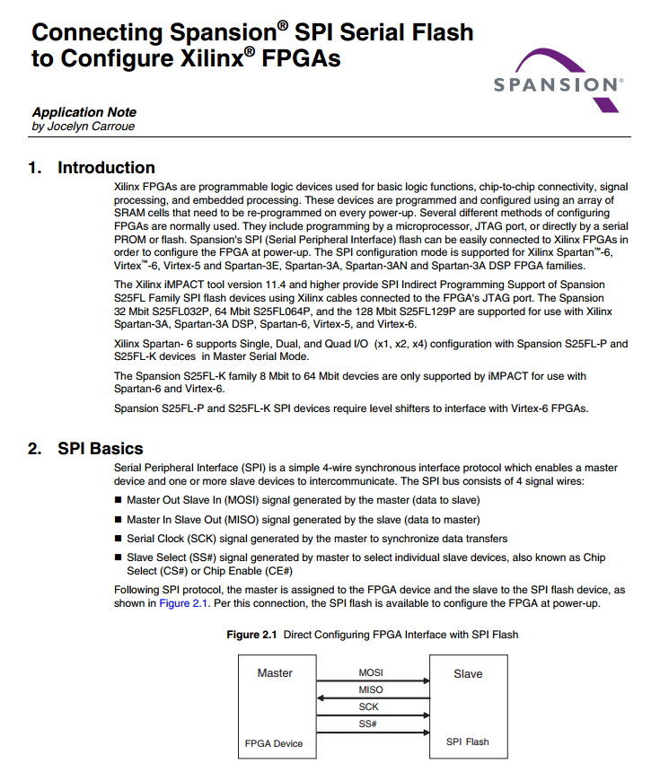
Picking an SPI flash
Size matters – SP6 bit file can easily range up to 00’s of KBs
“Building brick-less” means having headroom for a “golden” image
2Mbyte (2Mbit * 8) means we have room for at least two big images
Standard packages (scale easily, thanks SPI)
Cost & availability
Documentation & resources
☺

Slide 14
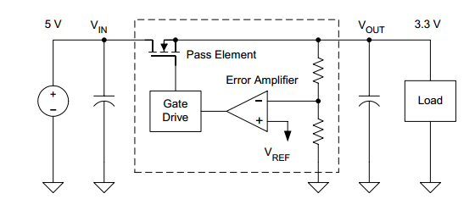
Power System Design
Two, independent power inputs
Arduino means we have access to 5V rail
DC input provides option for larger currents (>500 mA typical USB)
5V DC input requires >6.3V due to dropout voltage (Rdson of pass element generates voltage drop across LDO, dropout voltage is how we characterize this)
Require regulator to 3V3
Arduino 3v3 rail is super limited in terms of current (150-mA)
On-board, independent 3V3 supply provides access to more substantial current (~1A)
Require 1V2 rail for FPGA internal voltage (lower internal voltage = lower power consumption overall)

Slide 15
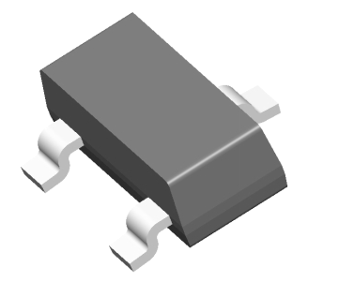
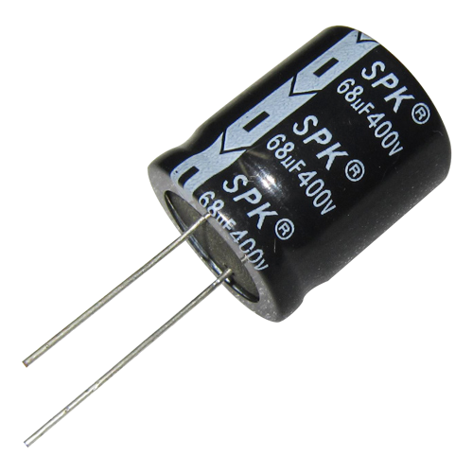
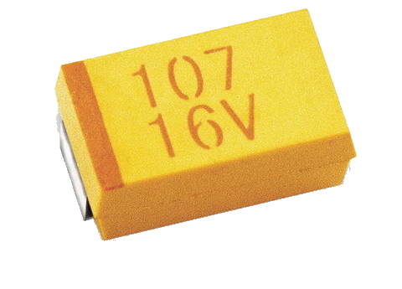
Picking an LDO
Voltage / current requirements aim high if this is your frist time, experience gets you in closer
Bigger the input, the higher the temperature, the more likely you are to need heatsinks
Lower the dropout voltage, the better (higher current tends toward higher dropout voltage)
Size (package size) – aim small
Adjustable regs tend toward lower performance than fixed – if your don’t need it, go fixed
Small external capacitors (SMT) – big caps = big board area
Avoid electrolytic / tantalum if possible
Good load regulation: < 0.3% is good
High PSRR / Low output noise
* You can spend way too much time on regulator selection…life is short. Pick one and move on.
Save the board space!

Slide 16
Power Supply Schematic

Slide 17
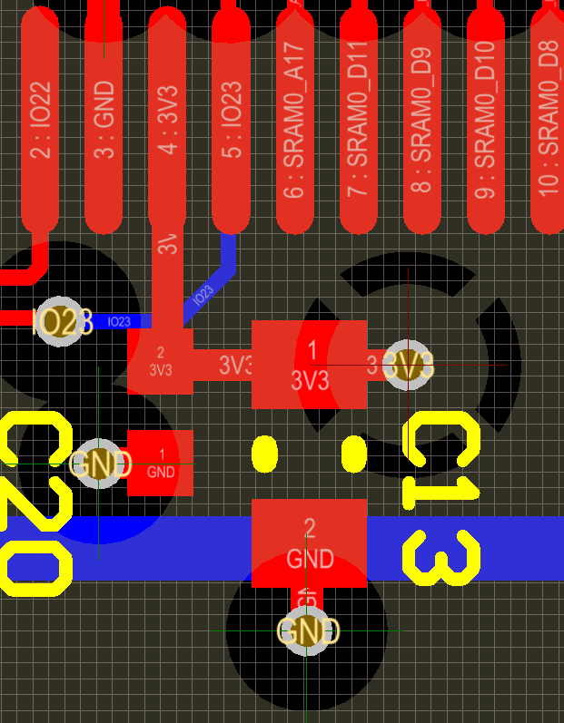
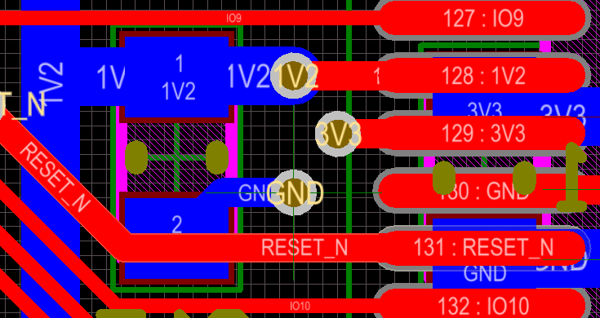
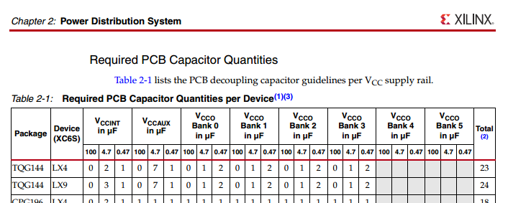
FPGA Decoupling 101
Quick decoupling basics
Decoupling provides instantaneous power to a changing load
Capacitors hold a charge close to the device, keep them close – the closer the better
FPGA Decoupling
FPGA decoupling is super finicky
Trust the FPGA vendor documentation
Going your own can be painful / super hard to troubleshoot
Routing decoupling on PCB
Always stay close to the pin (ok to go across pins on opp side of the board)
Always into the capacitor first, then into the component
Use your power planes - Power loves copper

Slide 18
Additional Memory Resources

Slide 19

SRAM / SDRAM / PSRAM?
SRAM
Asynchronous / Direct Access / No –Fuss
Smaller amount storage / dollar v. SDRAM
Very easy to implement (WYSIWYG)
Consumes less power than SDRAM
SDRAM
Complex to implement
Requires refresh
Consumes more power due to refreshing penalty
Synchronous
Larger amount of storage / dollar v. SRAM
PSRAM
Splits the uprights, sort of halfway step between SRAM and SDRAM
More expensive than SRAM
No wonky refresh stuff like SDRAM
Pro tip:
Different size SRAM / PSRAM ‘s often come in the same package sizes…FPGAs are IO
friendly. Build support for more address
pins than smaller sizes require and bask in the expandability of it all.

Slide 20
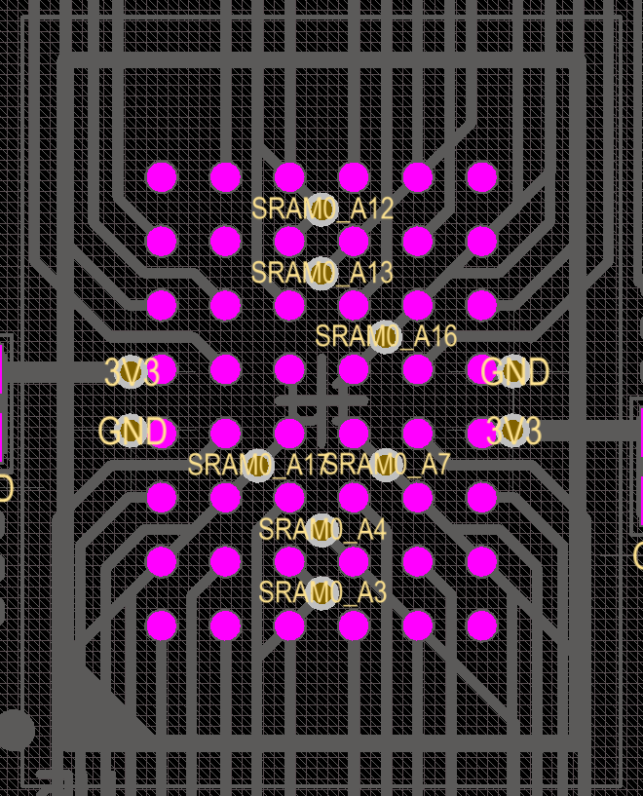
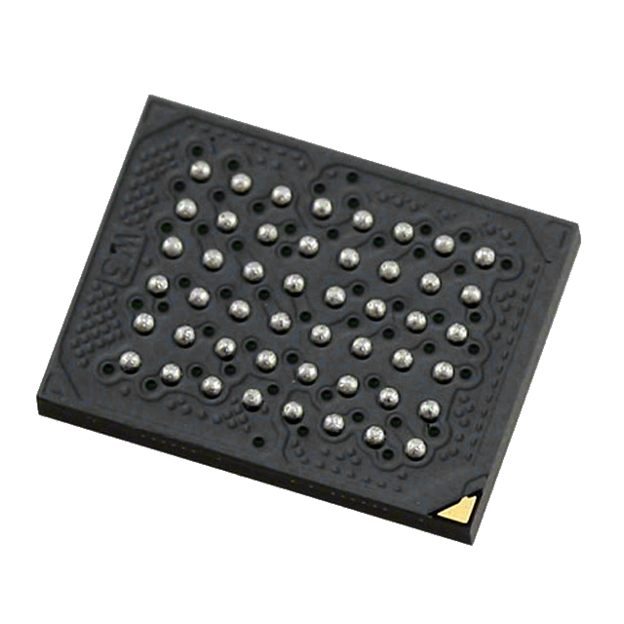
External Memory – big +1
FPGA Memory Resources are “expensive”
External memory relatively “cheap”
Shared memory access between FPGA and CPU is an option
CPU on-board FPGA, SRAM +1
Pro tip:
When soldering BGAs – remember to tent the vias…ie Soldermask over via holes.
Surface tension of vias > surface tension of BGA pad, tends to cause part “drift”
Buy a solder paste stencil. You’ll thank me.

Slide 21
IO Resources

Slide 22
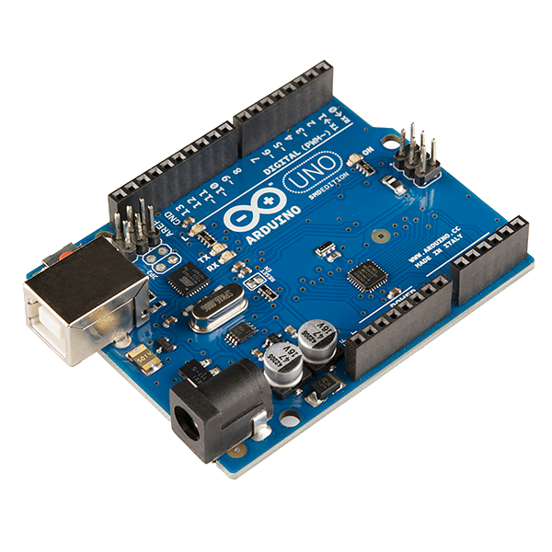
Interface to Arduino
SPI
ICSP on Arduino Requires Access to SPI flash
Multiplexer required – two SPI masters (FPGA & Ard)
Choice of multiplexer comes down to speed and series resistance mux introduces
Arduino Digital IO interface to FPGA
Bidirectional
FPGA IO are HiZ by default, Arduino digital pins will not harm the FPGA if they are connected and not used
No Arduino = More IO
Pro tip:
Arduino Vin can be dangerously high voltage (WYSIWYG with respect to Ard DC-in). Be careful!

Slide 23

User IO
Dipswitch
Always nice to have instant gratification
Switches give confidence that stuff is working
Cheap and easy event trigger
Not used = no problems
LEDs
Who doesn’t love an LED
LEDs give confidence something is working
Status LEDs save time (Power, Programmed, etc.)
Additional IO
It’s an FPGA afterall…Numerous IO
All FPGA IO must be “Constrained” to work
Constraint files map internal resources to external pins
Pro tip:
Build a constrain file for all of your IO and comment out what you don’t need…Saves the headache of having to refer back to schematics. Constrain files support comments. Use them.

Slide 24
Board Layout

